Slide 1
Addressing Mode
Computer Architecture Lecture 8

Slide 2
Addressing Modes
The CPU can access data in various ways. The data could be in a register, or in memory, or be provided as an immediate value. These various ways of accessing data are called addressing modes.
The purpose of the address field is to point to the current value V(X) of some operand X used by the instruction.
The addressing mode of X affects the following issues:
1. The speed with which V(X) can be accessed by the
CPU.
2. The ease with which V(X) can be specified and altered.

Slide 3
Different Addressing Modes
Immediate
Direct
Indirect
Register
Register Indirect
Displacement (Indexed)
Stack

Slide 4
Immediate Addressing
The simplest form of addressing is immediate addressing, in which the operand value is present in the instruction
This mode can be used to define and use constants or set initial values of variables.
Typically, the number will be stored in twos complement form; the leftmost bit of the operand field is used as a sign bit.
When the operand is loaded into a data register, the sign bit is extended to the left to the full data word size.
In some cases, the immediate binary value is interpreted as an unsigned nonnegative integer
Example:
A:=99
- In Intel 8085 series it is MVI A, 99
- In Motorola 690X0 series it is MOVE #99, D1 (D1=A)

Slide 5
Immediate Addressing Advantages and disadvantages
No memory reference to fetch data
Fast
Limited range

Slide 6
Direct Addressing
A very simple form of addressing is direct addressing, in which the address field contains the effective address of the operand:
It requires only one memory reference and no special calculation. The obvious limitation is that it provides only a limited address Space.
The storage location can be memory address or register.
Example:
A:=B
- In Intel 8085 series it is MOV A, B
- In Motorola 690×0 series it is MOVE D2, D1 (D1=A, D2=B)

Slide 7
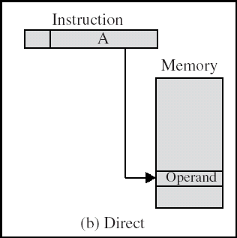
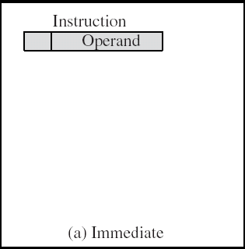
Immediate and Direct Addressing diagram

Slide 8
Indirect Addressing
Memory cell pointed to by address field contains the address of (pointer to) the operand
EA =(A)
Look in A, find address (A) and look there for operand.
The parentheses are to be interpreted as meaning “contents of”
ADD AX, (A)
Add contents of cell pointed to by contents of A to accumulator

Slide 9
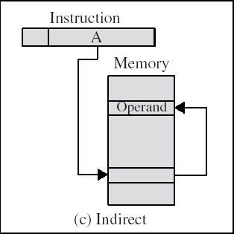
Indirect Addressing Diagram

Slide 10
Indirect Addressing Advantages and Disadvantages
Large address space
May be nested, multilevel, cascaded
e.g. EA = (((A)))
Draw the diagram yourself
Multiple memory accesses to find operand
Hence slower

Slide 11
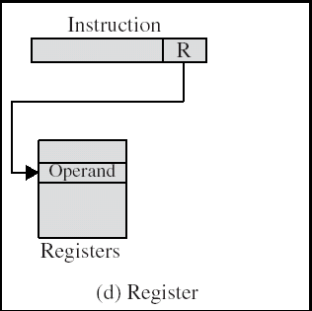
Register Addressing
In register addressing mode, the instruction specifies the name of the register in which the data is available.
EA=R
Direct addressing
Example
- MOV A, B - Move the content of B register to A register

Slide 12
Register Addressing advantages and disadvantages
No memory access
Very fast execution
Very limited address space

Slide 13
Register Indirect Addressing
In register indirect addressing mode, the instruction specifies the name of the register in which the address of the data is available. Here the data will be in memory and the address will be in the register pair.
EA = (R)
Operand is in memory cell pointed to by contents of register R
Example:
MOV A, M
- Move data from memory location specified by H-L pair to accumulator.

Slide 14
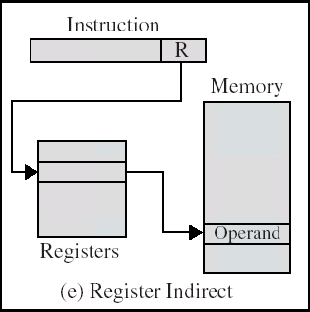
Register Indirect Addressing Diagram

Slide 15
Displacement Addressing
A very powerful mode of addressing combines the capabilities of direct addressing and register indirect addressing.
It is known by a variety of names depending on the context of its use, but the basic mechanism is the same. We will refer to this as displacement addressing.
Effective address=start address + displacement
Displacement addressing requires that the instruction have two address fields, at least one of which is explicit
EA = A + (R)

Slide 16
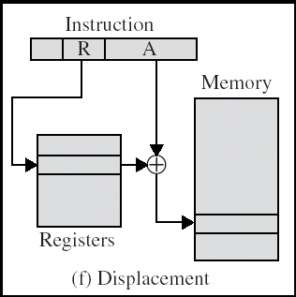
Displacement Addressing Cont.
The value contained in one address field (value = A) is used directly.
The other address field, or an implicit reference based on opcode, refers to a register whose contents are added to A to produce the effective address.

Slide 17
Displacement Addressing Diagram

Slide 18
Types of Displacement Addressing
• Relative addressing
• Base-register addressing
• Indexing

Slide 19
Relative Addressing
For relative addressing, also called PC-relative addressing, the implicitly referenced register is the program counter (PC).
That is, the next instruction address is added to the address field to produce the EA.
Typically, the address field is treated as a two’s complement number for this operation.
Thus, the effective address is a displacement relative to the address of the instruction.

Slide 20
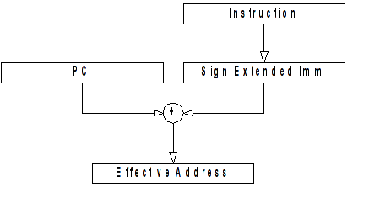
Relative Addressing

Slide 21
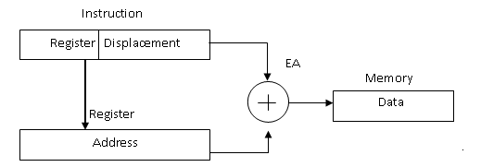
Base Register Addressing
The referenced register contains a main memory address, and the address field contains a displacement (usually an unsigned integer representation) from that address.
Segment registers in 80x86

Slide 22
Indexing
The address field references a main memory address, and the referenced register contains a positive displacement from that address.
Note that this usage is just the opposite of the interpretation for base register addressing.
Of course, it is more than just a matter of user interpretation. Because the address field is considered to be a memory address in indexing, it generally contains more bits than an address field in a comparable base-register instruction.
Good for accessing arrays (Read Yourself)

Slide 23
Stack Addressing
A stack is a linear array of locations. It is sometimes referred to as a pushdown list or last-in-first-out queue.
The stack is a reserved block of locations.
Items are appended to the top of the stack so that, at any given time, the block is partially filled.
Associated with the stack is a pointer whose value is the address of the top of the stack.
The stack pointer is maintained in a register. Thus, references to stack locations in memory are in fact register indirect addresses.

Slide 24
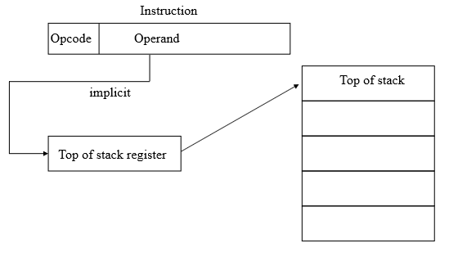
Cont.
Operand is (implicitly) on top of stack
e.g.
ADD (Pop top two items from stack and add and push)

Slide 25
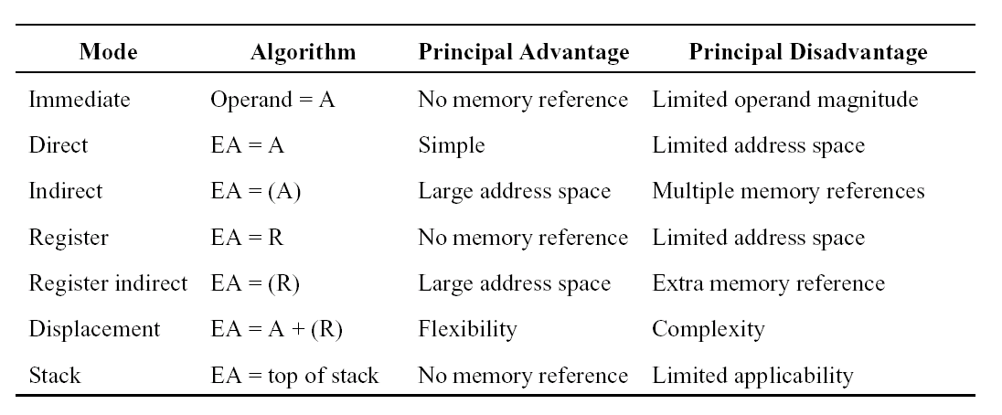
Summary

